Slide 1
Predicting Depression Rates
Ryan Nebblett, Ali Manekia, Chris Cornelius, Ben Pietrancosta
March 15, 2023

Slide 2
Team introduction
Ben Pietrancosta -> Github repo manager/project manager
Ryan Neblett -> Data management SME
Chris Cornelius -> Machine-Learning model SME
Ali Manekia -> Visualization SME

Slide 3
Agenda
Problem Statement
Data Overview
Machine Learning Modeling
Dashboard

Slide 4
Problem Statement
What features best predict depression rates at a county level in the US? Are there geographical patterns for depression?
Impact: Providing a layman’s understanding of what may indicate depression.

Slide 5
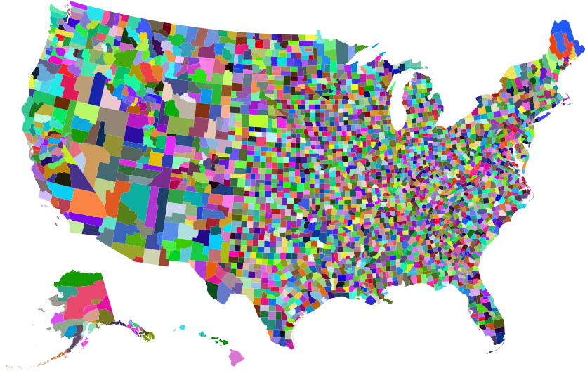




Data overview: Raw data
Data sets:
Health -> Medical conditions
Transportation -> Resident travel behavior
IRS -> Income data
Employment -> Job titles and average income
Data sources and relationships -> Federal government data joined by FIPS code.

Slide 6
Data overview: Data storage
Database tables -> Each data set corresponds to a unique table in Postgres
Reference and join tables -> Used intermediary tables to better define certain data via PK/FK relationships, e.g. is the definition of job title.

Slide 7
Machine Learning Modeling Process Overview
Data Preprocessing
Manual feature selection from 2,400 independent variables to 30
Z-score scaling (all numeric)
Reduce multicollinearity through VIF calculation and feature reduction
Linear ML Models for Continuous Variable: OLS, Ridge, LASSO
Non-Linear ML Models for Continuous Variable:
Random Forest Regression on scaled subset of features
Random Forest Regression on entire set of unscaled features

Slide 8
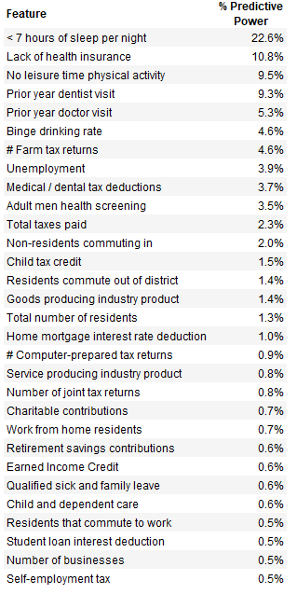
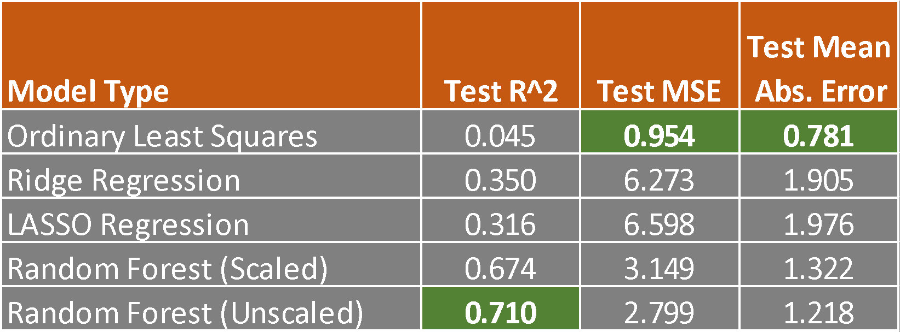
Machine Learning Modeling Results Comparison

Slide 9
Visualization
Tableau visualization -> Why we chose Tableau?
Visualization form -> Geographic heatmap of the US at a FIPS code/County level.
Meaning of color -> The color scale goes from blue to red
Details -> When hovering over the map, it shows:
County Name
FIPS Code
Depression Rate amongst adults
When you click on a certain fips code, the table will show the resulting values of all the other measures.

Slide 10

Tableau Visualization

